Slide 1
Special Projects Updates for Charters
Quarter 3 Meeting
February 13, 2025

Slide 2
AGENDA
Grant Specific
IDEA Updates
Title II and IV Updates
Special Projects Updates
Reimbursement Reminders
R.A.N Reminders
Procurement Update
Taggable Items Reminders

Slide 3

2024-2025
INDIVIDUALS WITH DISABILITIES EDUCATION ACT GRANT
Notes:
Each year, we carefully review the allocation of IDEA funds to ensure they are used effectively to support students with disabilities. When our budget allows, we are pleased to provide both charter schools and our own schools with clerical hours to assist in the administration of special education services. However, in years when the funding is more limited, we prioritize ensuring that everyone receives supply money to directly support educational needs. We appreciate your understanding and commitment to making the most of the resources available to benefit our students.

Slide 4

GENERAL GUIDELINES
Excess Cost
Supplies must be an excess cost of providing special education and related services. Excess costs are additional expenses the school incurs when educating students with disabilities, beyond what it spends on average for all students.

Slide 5
R
REASONABLE
Reasonable costs are expenses that a prudent person would consider sensible and appropriate under the circumstances.
“Would an average person think this is a sensible way to spend grant funds?”
A
ALLOCABLE
For a cost to be allocable, it must have a clear connection to the grant and contribute to its objectives.
“Can the connection between this cost and the project's objectives be clearly demonstrated?”
N
NECESSARY
Necessary costs are expenses that are essential for achieving the goals of the grant project.
“Is this expense required to accomplish our grant objectives?”

Slide 6

2024-2025
TITLE II & TITLE IV
Notes:
Each year, we carefully review the allocation of IDEA funds to ensure they are used effectively to support students with disabilities. When our budget allows, we are pleased to provide both charter schools and our own schools with clerical hours to assist in the administration of special education services. However, in years when the funding is more limited, we prioritize ensuring that everyone receives supply money to directly support educational needs. We appreciate your understanding and commitment to making the most of the resources available to benefit our students.

Slide 7
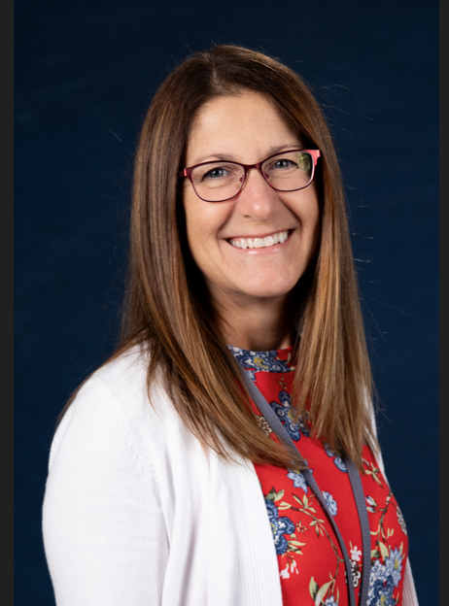
New Coordinator – Title II and IV
Jessica Soto

Slide 8
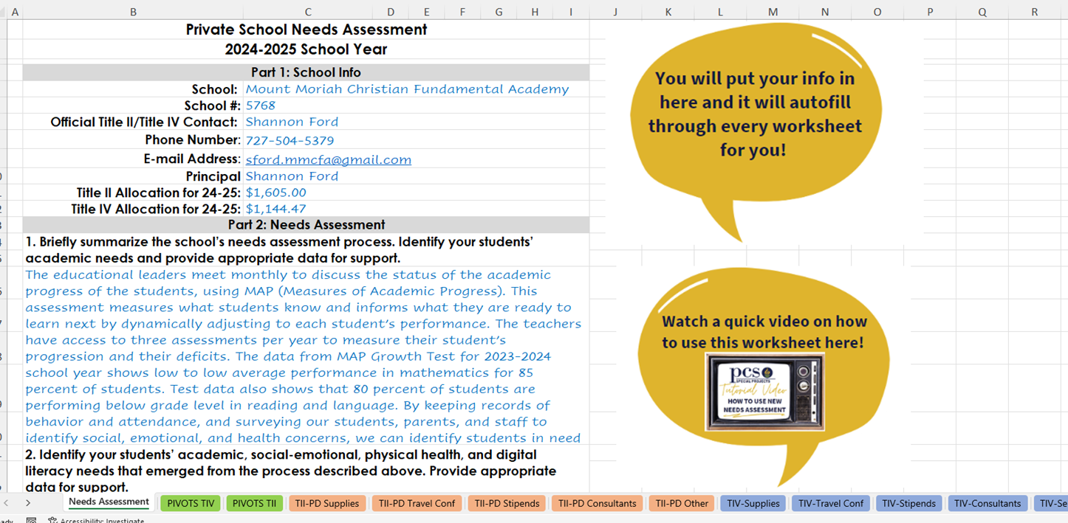
NEEDS ASSESMENT DETAILS

Slide 9
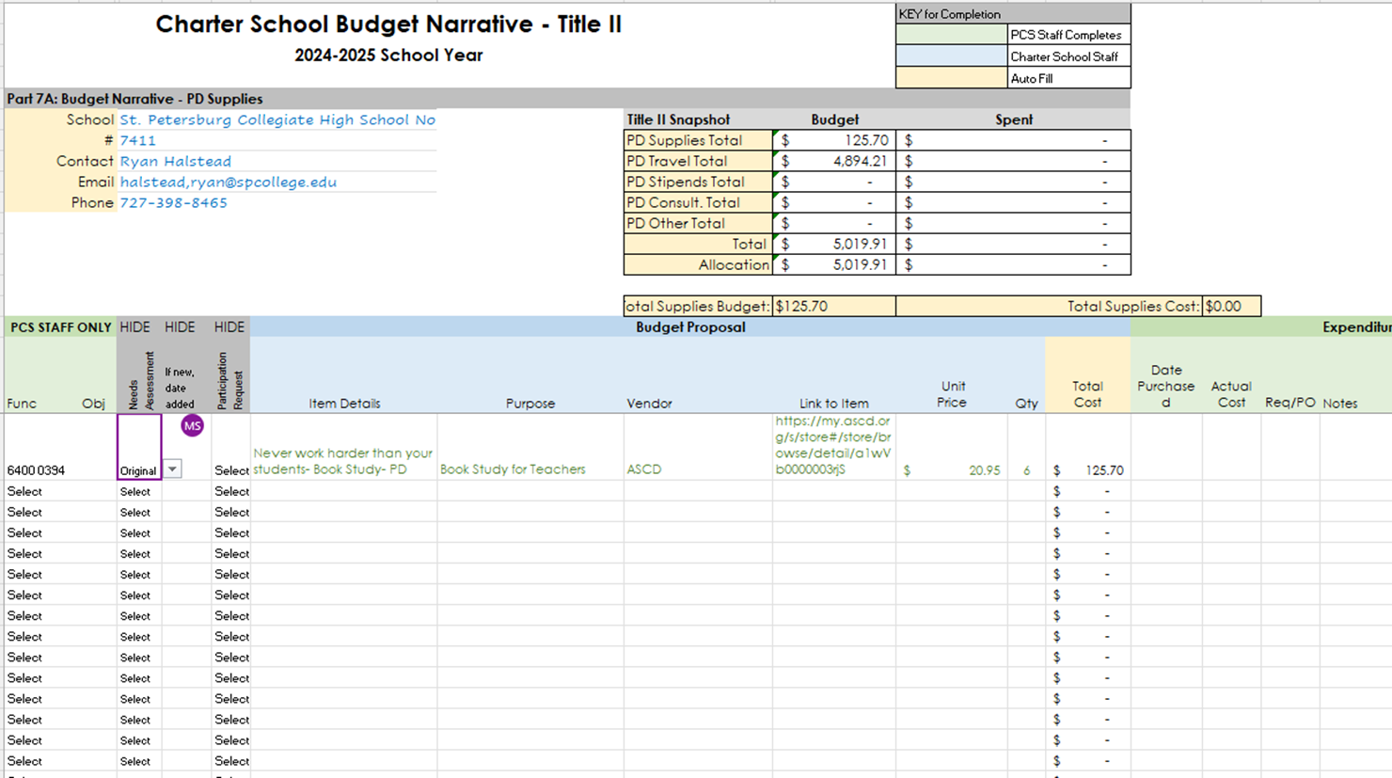
NEEDS ASSESMENT DETAILS

Slide 10

NEEDS ASSESMENT DETAILS

Slide 11
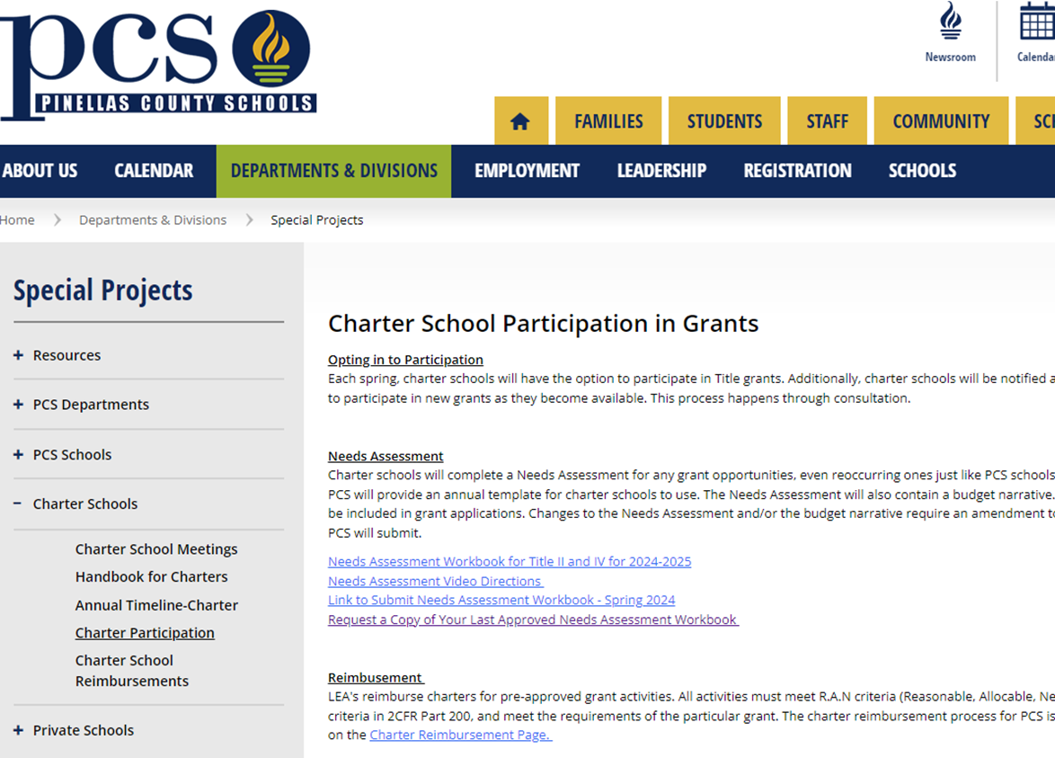

NEEDS ASSESMENT DETAILS

Slide 12

TITLE II & IV AMENDMENTS
Email Invite
Review Needs
Assessment
Amendments will occur in Fall, Winter and Spring and schools will receive email notification the month prior so they will have an opportunity to request changes to their budget.
Schedule Session with Calendly
Prepare Changes Ahead of Time
Meet on Teams & Make Changes Live
Wait for FDOE approval to Spend

Slide 13
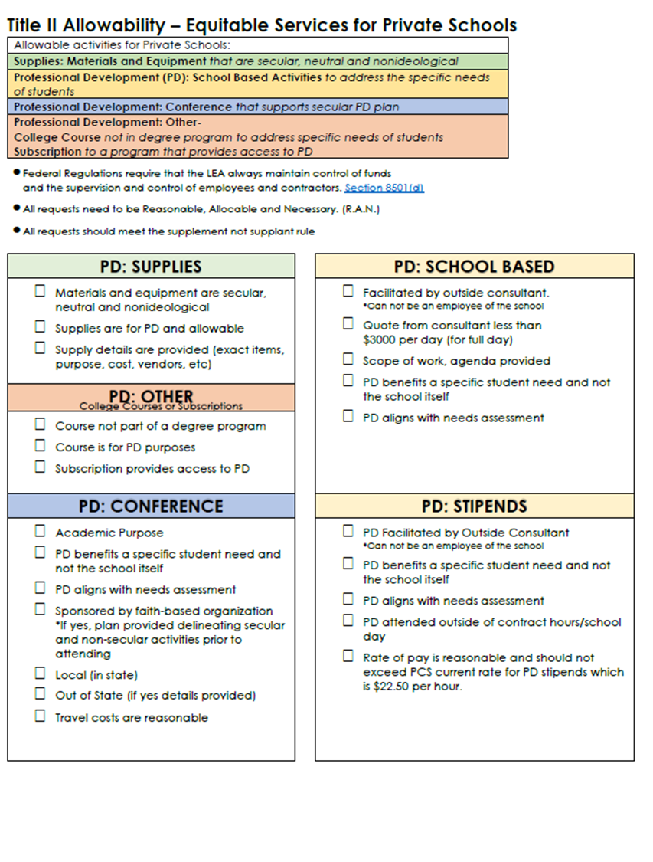




TITLE II & IV REMINDERS
Reasonable, Allocable, Necessary

Slide 14

TITLE II & IV REMINDERS
Reasonable, Allocable, Necessary

Slide 15
TITLE II & IV REMINDERS
Reasonable, Allocable, Necessary

Slide 16

TITLE II & IV Planning
FY 2025-2026

Slide 17

SPECIAL PROJECTS
GRANT UPDATES
Charter Schools March 2024

Slide 18
2024-2025
Procurement Updates
Notes:
ESSER is ending and all reimbursements we have received are currently being processed. Liquidation is November 20th after which nothing more can be done with ESSER funds.

Slide 19
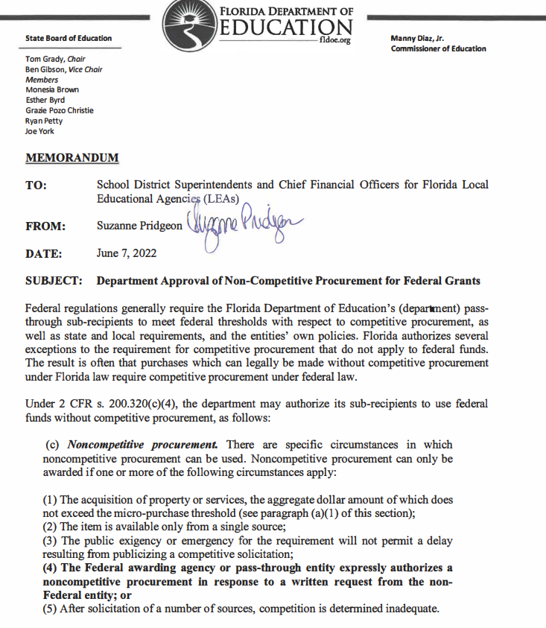
PAST
Clean Up/Next 30 Days
PRESENT
Moving Forward
FUTURE
New System

Slide 20




REIMBURSEMENT PROCESS
Proof of
Payment
Cover Letter
Invoice

Slide 21
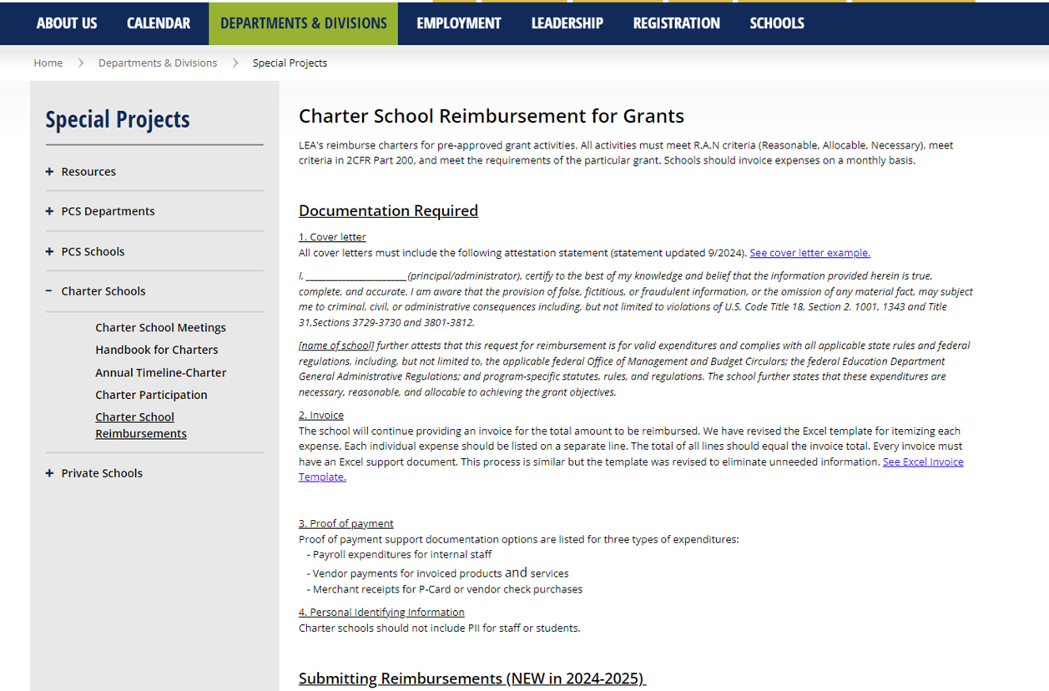
REIMBURSEMENT PROCESS

Slide 22
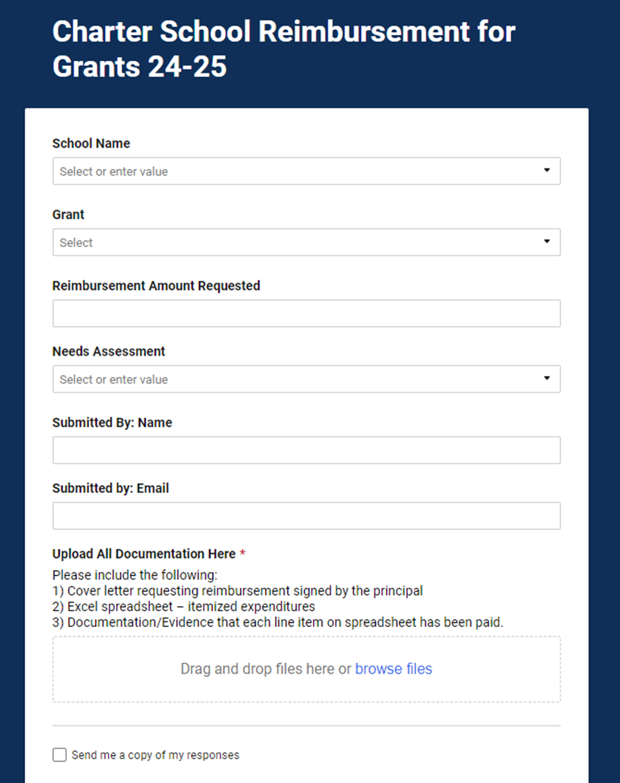
REIMBURSEMENT PROCESS

Slide 23

REIMBURSEMENT HANGUPS
Bank Back Up- Partial months
Addition- Total amount on itemized spreadsheet
Tax- Not removed on purchases, receipts, etc.
Frequency - Combining many months
Overabundance- Too much unnecessary back-up documentation

Slide 24
R
REASONABLE
Reasonable costs are expenses that a prudent person would consider sensible and appropriate under the circumstances.
“Would an average person think this is a sensible way to spend grant funds?”
A
ALLOCABLE
For a cost to be allocable, it must have a clear connection to the grant and contribute to its objectives.
“Can the connection between this cost and the project's objectives be clearly demonstrated?”
N
NECESSARY
Necessary costs are expenses that are essential for achieving the goals of the grant project.
“Is this expense required to accomplish our grant objectives?”

Slide 25

TAGGABLE ITEMS
Please make sure that when you receive tags for taggable items that you complete the form that comes with them which provides us with the serial number. When this is returned to purchasing, they complete the asset in TERMS officially making it part of inventory and attached to the grant.
We need these forms ASAP and will now be making a follow up request as part of the process every time,
Its not just a “checkmark” item – It’s really important!

Slide 26

More to Come...

Slide 27


THANK YOU!
Nichole Delemeester
727-588-6000 ext.1440
DelemeesterN@pcsb.org
Jessica Soto
727-588-6226
SotoJ@pcsb.org
Coral Marsh
727-588-6311
MarshCo@pcsb.org

